Slide 1
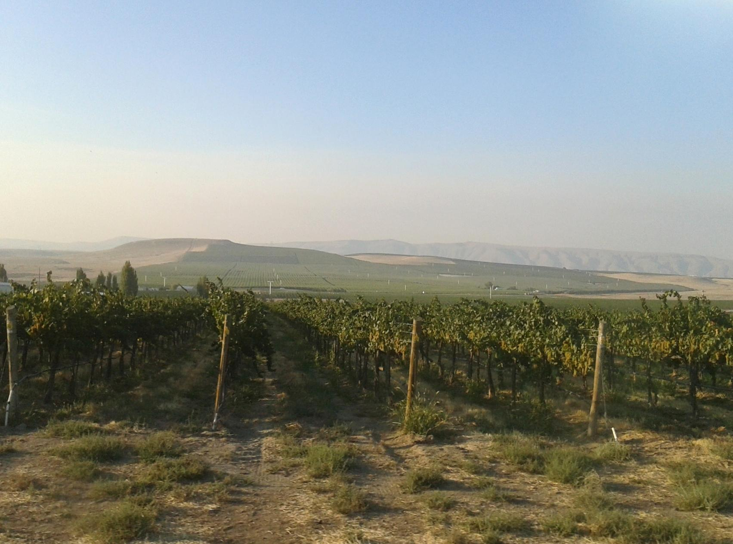
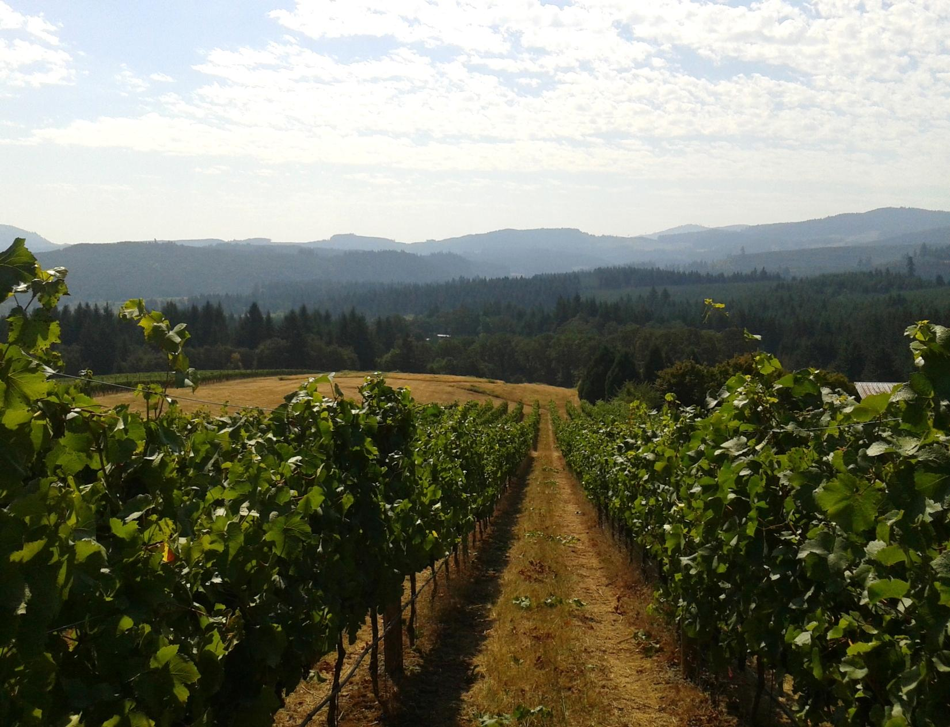
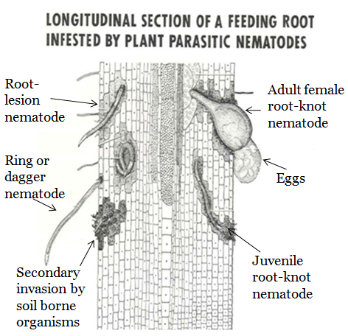
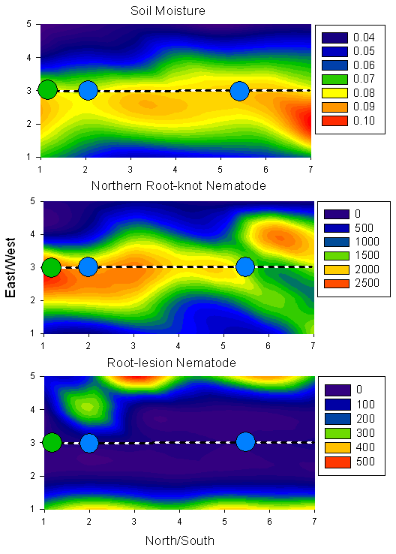
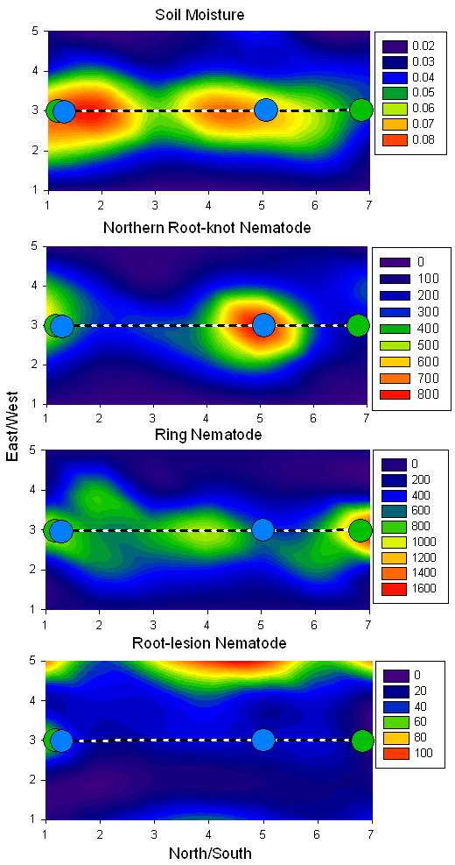
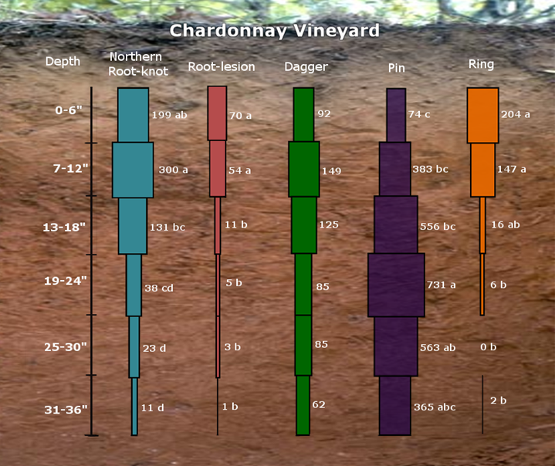
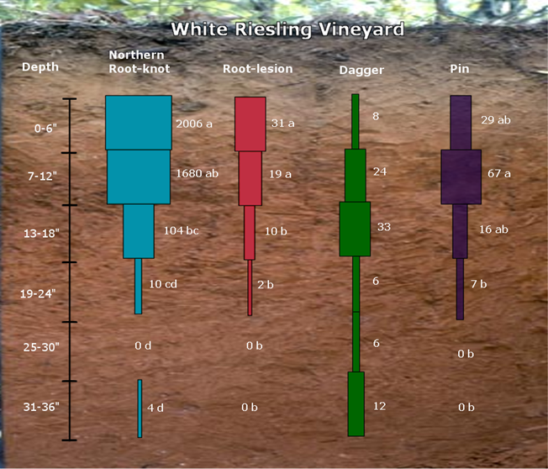
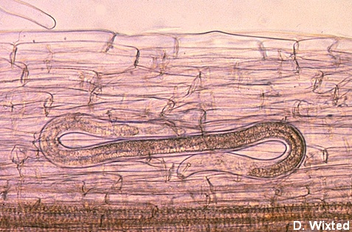
Spatial Distribution of Plant-Parasitic Nematodes in Eastern Washington Vineyards A.D. Howland¹, P.A. Skinkis¹, R.P. Schreiner², and I.A. Zasada² ¹Department of Horticulture, Oregon State University, Corvallis, OR 97330 ²USDA-ARS Horticultural Crops Research Laboratory, Corvallis, OR 97330
Introduction
A constraint to the production of grapes in
Washington are plant-parasitic nematodes, which
are microscopic, aquatic roundworms that live and
move in water filled pore spaces in the soil. Plant- parasitic nematodes impact vine productivity by: limiting the plant’s ability to take up water and
nutrients, preventing root elongation, destroying
root tissue, and removing plant nutrients. This
causes the grapevine to have stunted growth,
reduced vigor, and lower yield.
Plant-parasitic nematodes that are commonly associated with V. vinifera grapevines include Meloidogyne hapla (Northern root-knot), Pratylenchus sp.(root-lesion), Xiphinema americanum (dagger), Mesocriconema xenoplax (ring), and Paratylenchus (pin). In Eastern Washington, Northern root-knot nematodes, which cause the formation of galls on the roots, and dagger nematodes, which can vector the tomato ringspot virus, are considered the most economically-important. A survey conducted in 2003 showed that over 50% of the vineyards sampled contained both Northern root-knot and dagger nematodes (data not shown). However, surprisingly little is known about plant-parasitic nematode’s distribution and pathogenicity in Washington vineyards. Washington grape growers therefore lack basic information regarding pre-plant management of plant-parasitic nematodes. The goal of this study was to investigate the horizontal and vertical distribution of plant-parasitic nematodes in eastern Washington vineyards.
Results
Vertical Distribution
Soil depth was highly significant (p < 0.0001) for all plant-parasitic nematode except for dagger nematode (Figures 1 and 2).
Soil depth was also highly significant (p < 0.0001) for soil moisture, with decreasing soil moisture with depth (data not shown).
At both vineyards, Northern root-knot and root-lesion nematodes were concentrated in the upper 18” of soil; this was also true for ring nematode which was only present at the Chardonnay vineyard.
There was a significant positive correlation between soil moisture and Northern root-knot, root-lesion, and ring nematodes (p < 0.0001).
Sampling location was significant only for soil moisture at the White Riesling vineyard with less moisture in the alleyway (data not shown).
At the Chardonnay vineyard, sampling location was significant (p < 0.0001) for soil moisture and Northern root-knot nematode, with average population densities under the emitter of 87 nematodes/250 g soil and 7 nematodes/250 g soil in the alley.
Horizontal Distribution
Northern root-knot and ring nematode populations were concentrated in the vine row (Figures 3 and 4).
Northern root-knot nematode populations were related to soil moisture (p < 0.0001; r² = 0.1- 0.5 ) at both vineyards; a similar trend was observed for ring nematode, which was only present at the Chardonnay vineyard (p < 0.0003; r² = 0.1).
In both vineyards, the distribution of dagger nematode populations was random and not significantly related to moisture (p > 0.05) (data not shown).
Root-lesion nematode populations were concentrated in the alleys at both locations (Figures 3 and 4).
Figure 4. Horizontal distribution of plant-parasitic nematode population densities and soil moisture in a White Riesling vineyard.
Figure 3. Horizontal distribution of plant-parasitic nematode population densities and soil moisture in a Chardonnay vineyard.
Figure 1. The vertical distribution of plant-parasitic nematodes to a depth of 36 inches in a Chardonnay vineyard.
Figure 2. The vertical distribution of plant-parasitic nematodes to a depth of 36 inches in a White Riesling vineyard.
Methods
Vineyards included in study:
34-year-old Chardonnay – sandy loam soil
38-year-old White Riesling – silt loam soil
Determination of vertical distribution of plant-parasitic nematodes:
5 plots were established at each vineyard
In each plot, 6 soil samples up to 3’ deep were
collected: directly under the emitter (M), North (N),
South (S), East (E), and West (W) of the emitter, and
1 sample 2’ into the alleyway (A)
Each soil sample was partitioned into 6” segments: 0-6”, 6-12”,12-18”, 18-24”, 24-30”, and 30-36”
Plant-parasitic nematode densities and soil moisture were determined for each sample
Determination of horizontal distribution of plant-parasitic nematodes:
5 plots were established at each vineyard
Each plot was 5’ x 7’ and spanned between 2 vines
A composite soil sample to a depth of 18” was taken at 1’ increments in each plot
Plant-parasitic nematode densities, soil moisture, and fine root density were determined for each sample
Each colored block is the representative number of nematodes per six inch increment. The number beside the bocks represent the mean (n = 5) of actual number of nematodes per 250 g of soil. Means followed by the same letter are not significantly different according to Tukey’s honestly significant difference test (p > 0.05).
Root-lesion nematode
Northern root-knot
Root
Female
Discussion
Northern root-knot and ring nematodes (where present) were positively related to soil moisture and fine root density, indicating that grape is their primary host in this system.
As a result of the high moisture content around the grapevine row, the highest population densities of Northern root-knot nematodes were found concentrated 3’ band.
Root-lesion nematodes were congregated only in the alleyways at both vineyards, implying that plants other than grape are the primary hosts for this nematode in Washington vineyards.
At both vineyards, Northern root-knot and root-lesion nematode population densities were concentrated in the upper 18” of the soil profile; in the Chardonnay vineyard, this was true also for ring nematodes.
Conversely, there was no consistent trend in dagger nematode distribution vertically or horizontally within the vineyards, and there was no relationship between population densities of this nematode and soil moisture.
Results were inconsistent in both vineyards in regard to the distribution of pin nematodes; however, the role that pin nematodes play in the pathogenicity of grapevines is minimal.
Conclusion
We have demonstrated that plant-parasitic nematodes very in their distribution in Eastern Washington vineyards. Northern root-knot and ring nematodes are predominately distributed in the wetting zone of a vineyard up to a depth of 18”. This information indicates that there is potential to reduce the size of the area to be treated when targeting these plant-parasitic nematodes. However, this strategy would not be effective against dagger nematodes because of their widespread distribution throughout the soil profile. Our data also shows that root-lesion nematodes are not a major parasite of grapes in Eastern Washington. Having a knowledge of the distribution of plant-parasitic nematodes in vineyards will give Washington grape growers the confidence to target areas within the vineyard to maximize nematode control.
Thank you to Washington Grape & Wine Research Program for funding this research

